Slide 1
Drive More Business to Your Business With Reviews
Monitor & Generate Reviews
Learn whenever a customer leaves a review across our 60+ partner local search sites, and generate new reviews from your customer audience.
Easily Respond To Reviews
Responding to reviews shows customers you’re listening — and it leads to an increase both your average ranking and customer advocacy. Respond to reviews everywhere customers leave them from one central dashboard.
Promote Reviews for SEO
Differentiate your business in local search results by adding reviews to your website. Show search engines you drive great experiences and give customers the confidence to click on — and visit — your business.
77%
of consumers read online reviews of local businesses on both reviews sites and businesses’ own websites.
Businesses with 6-10 reviews are
60%
more likely to have a 3+ star rating than businesses with 1-5 reviews
44%
of consumers say reviews must be written within one month to be relevant
Top 3
local SEO ranking factors: relevance, distance, and prominence

Slide 2
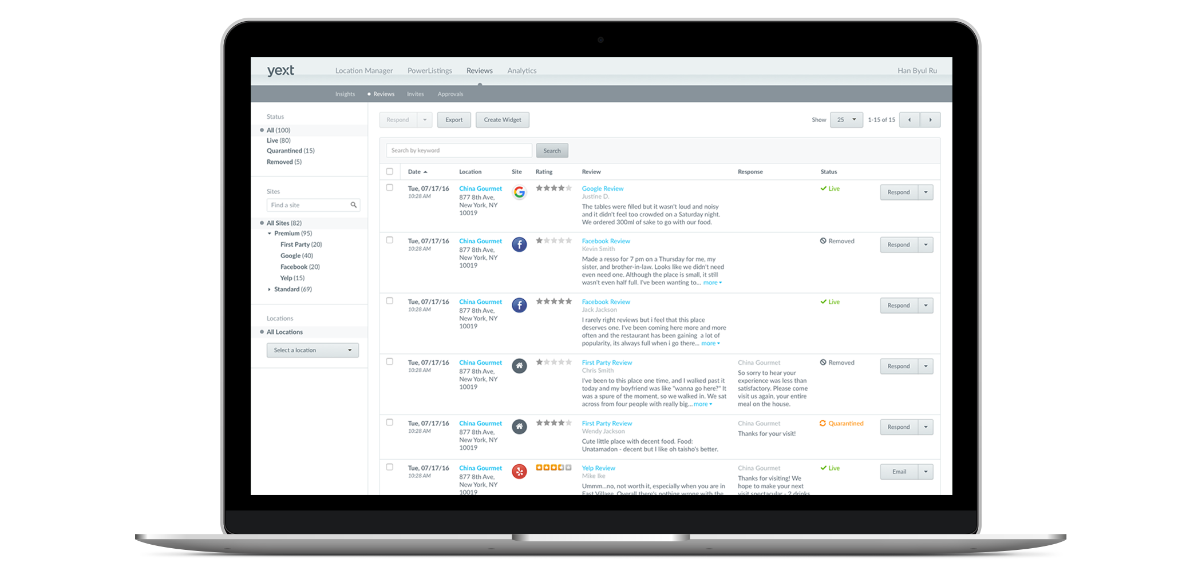
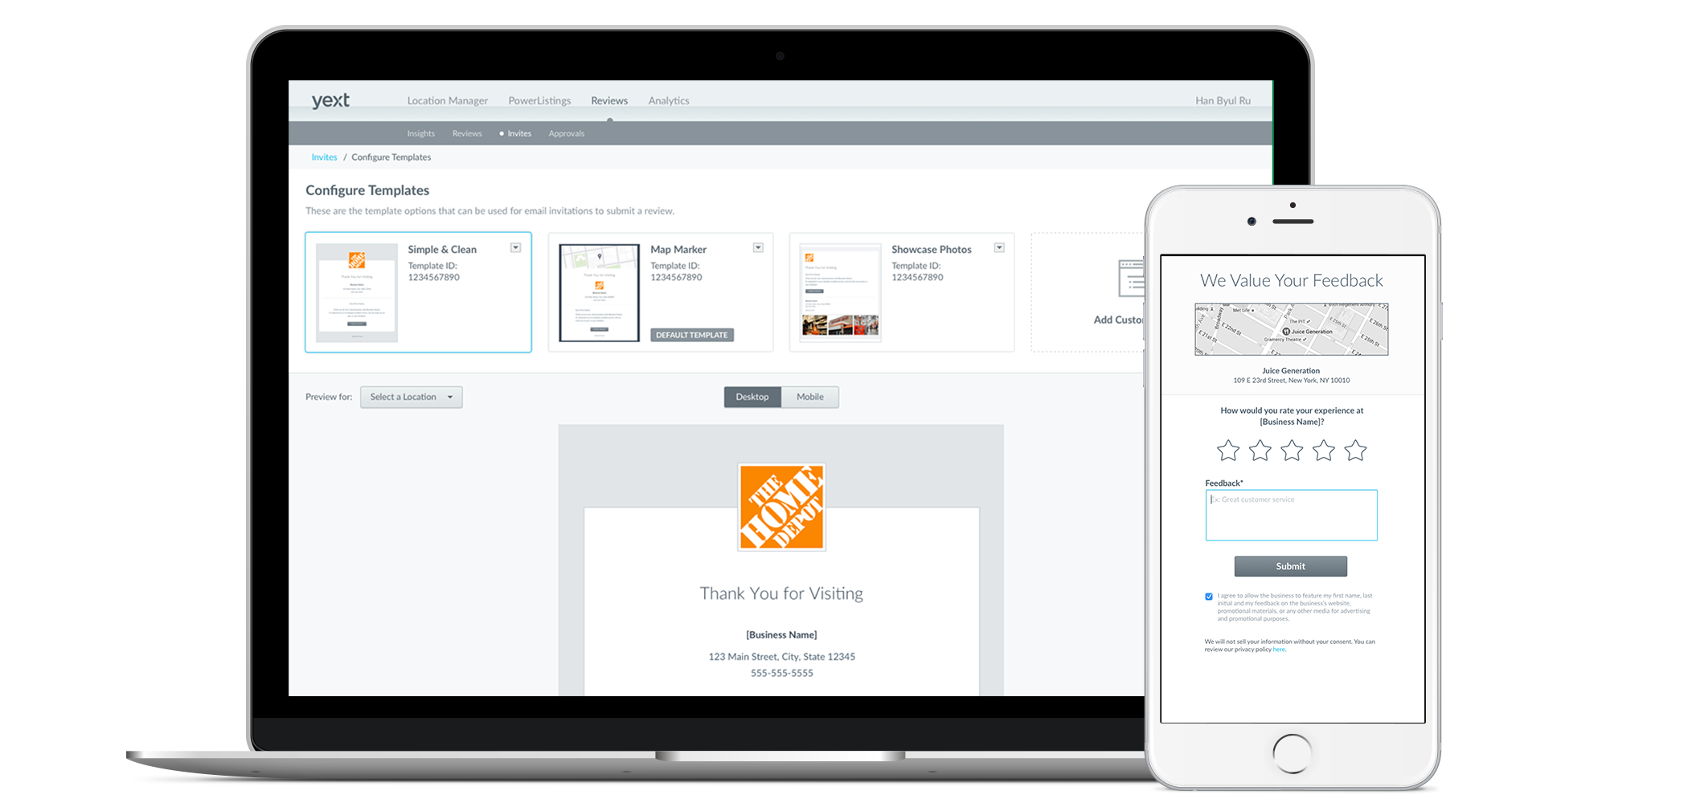
Monitor and Generate Reviews to Understand and Improve Your Ratings
Stay on top of all the reviews consumers leave about you across the web, and generate new reviews from your audience.
Our direct integrations with top third-party reviews sites and apps pull in all the reviews that your business receives — so you can see everything in one place.
Generate more reviews from your customer audience by setting up branded emails that you can send to customers after they transact, to your existing email list, and more. On average, businesses with more reviews see an increase in average rating.
77%
of consumers read online reviews of local businesses on both reviews sites and businesses’ own websites.
Businesses with 6-10 reviews are
60%
more likely to have a 3+ star rating than businesses with 1-5 reviews

Slide 3
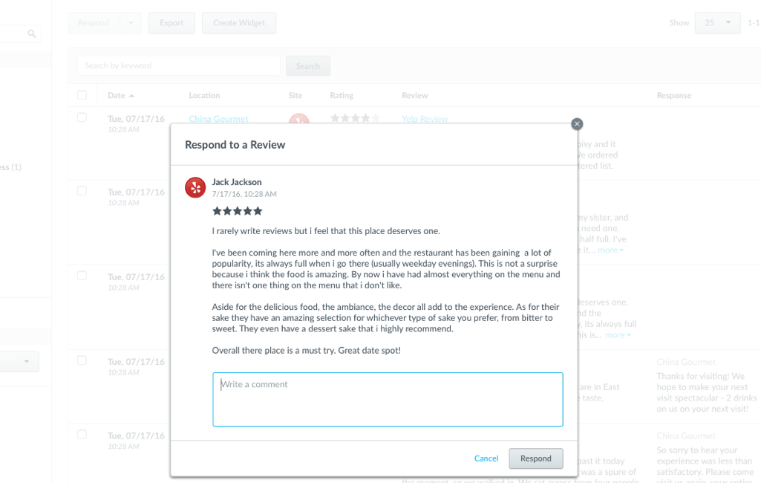
Respond to Reviews to Show Customers You’re Listening
Responding to reviews shows customers you’re listening. It also boosts both your average review rating and makes customers more likely to recommend you.
Respond to reviews everywhere customers leave them — on third-party sites and in response to your review requests — from one centralized dashboard.
16%
Increase in customer advocacy when you respond to reviews
Businesses who respond to reviews are
68%
more likely to increase their rating by 0.5 stars in 6 months

Slide 4
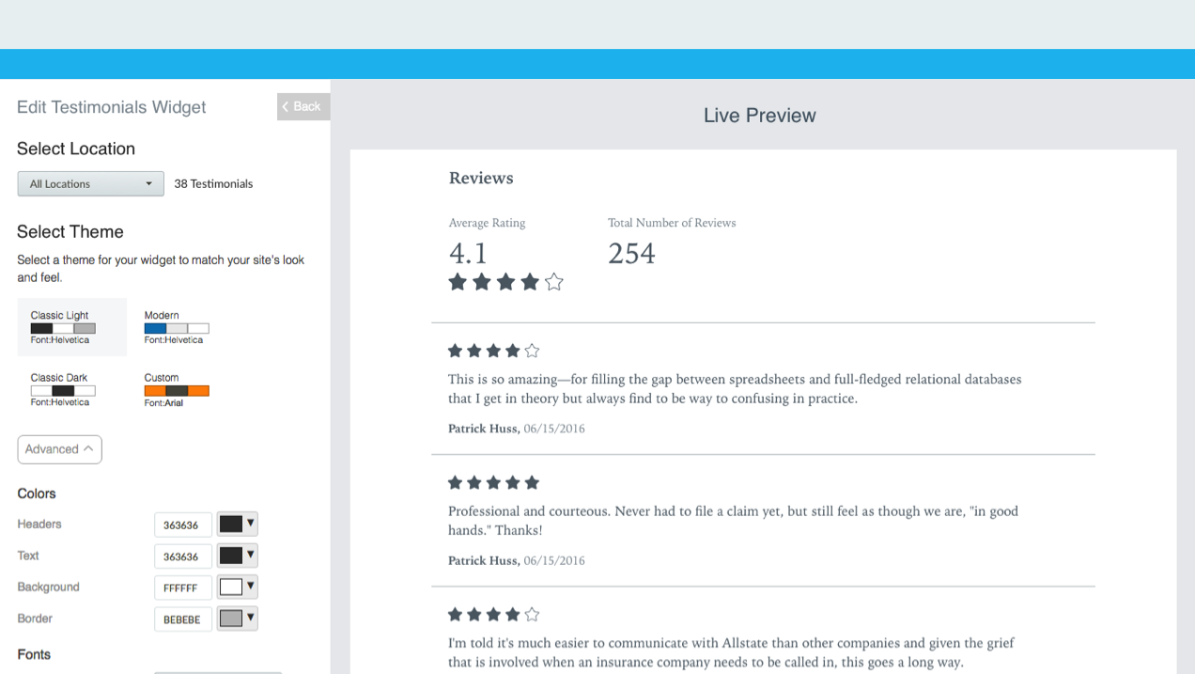
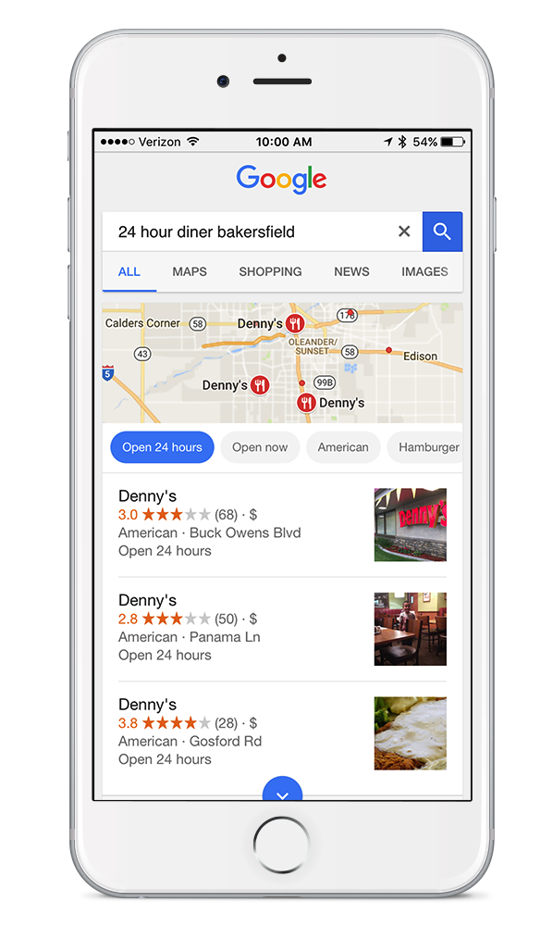
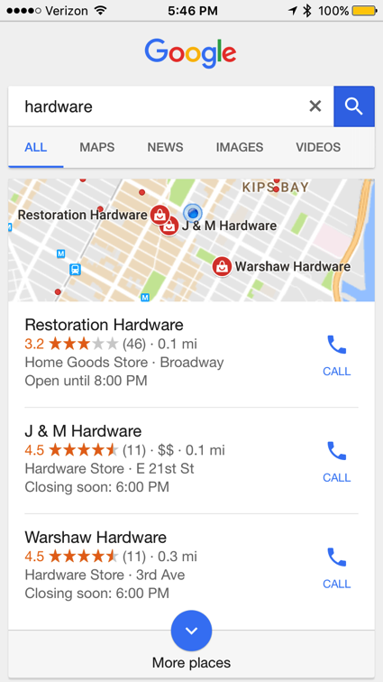
Promote Reviews On Your Website to Boost Your Ranking in “Near Me” Search
Reviews are about far more than customer service. When you promote the reviews you generate on your website, you show search engines that your business is worth visiting — which boosts your ranking in “Near Me” search and drives more business.
We’ll work with you to get the reviews you generate onto your website with SEO best practices, so search engines have confidence in showing your business at the top of their results.

